Slide 1
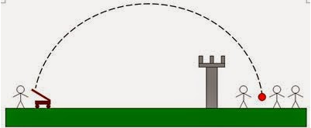
PROJECTILE MOTION
Where we literally shoot first and ask (hard) questions later!

Slide 2
CONTENTS
Forces on projectile in flight.
Launching projectile obliquely (various examples).
Same level (plus assumptions)
Different levels (assumptions vanish!)
Different sets of initial conditions/information
Hitting a target (mid-air)
Optimum Launch Angle
The Monkey & The Hunter

Slide 3

FORCES ON PROJECTILE
*Most of the time, we ignore air resistance, but in reality, it is the only other force at play.
*If we account for air resistance, the arc of the projectile will change.
F_{Drag}
F_{Drag}
F_{g}
F_{Drag}
F_{g}
F_{g}
F_{Drag}
F_{Drag}
F_{g}
F_{g}

Slide 4
LAUNCHING PROJECTILES
Some things we like to find in projectile motion questions:
Initial velocity & final velocity of projectile (magnitude & direction).
Components (vertical & horizontal) of initial/final velocity.
Range (Max. Horizontal Displacement).
Max. Height (Max. Vertical Displacement).
Time to Max. Height.
Time of Flight.
You won’t always be required to find each of these things; in fact, more often you will be given some of this information and asked to use it to calculate the rest. It is worth noting again that, for most questions involving calculation, we are expected to ignore air resistance.

Slide 5
LAUNCHING PROJECTILES (SAME LEVEL)
Launching projectiles such that they start and finish at the same elevation is one type of problem that we will be required to solve. Fortunately, this allows us to make certain assumptions in solving the problem.
For one thing, the flight path is considered symmetrical about the point of maximum height. This means that, if we can find the time for the projectile to reach maximum height, then we can double it to find the total time of flight.

Slide 6
LAUNCHING PROJECTILES (SAME LEVEL)
For another thing, it allows us to assume that the speed (and angle from the horizontal) are the same at the start/finish of the projectile arc.
θ
θ

Slide 7
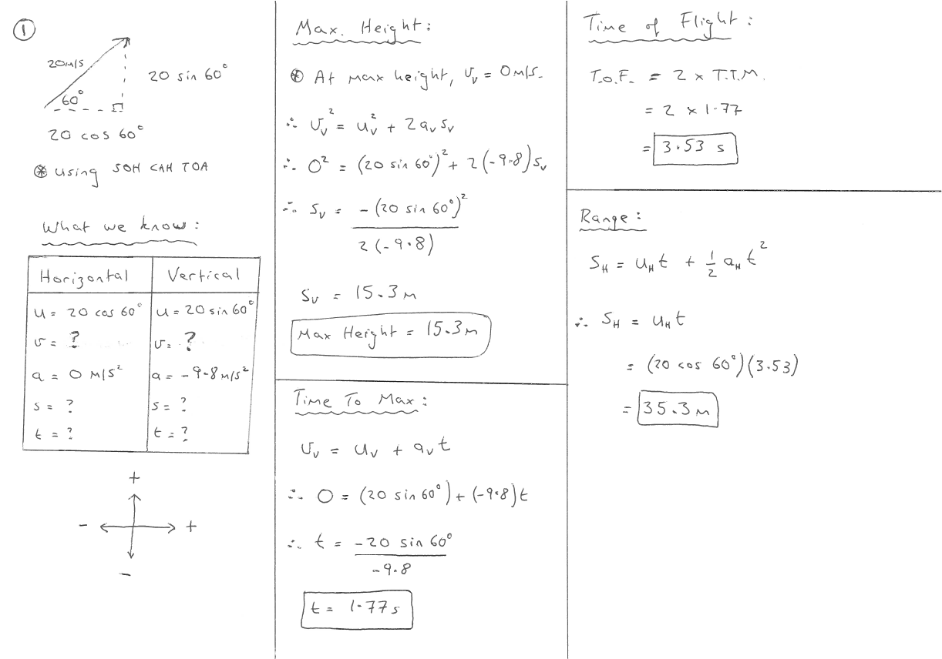
0

Slide 8
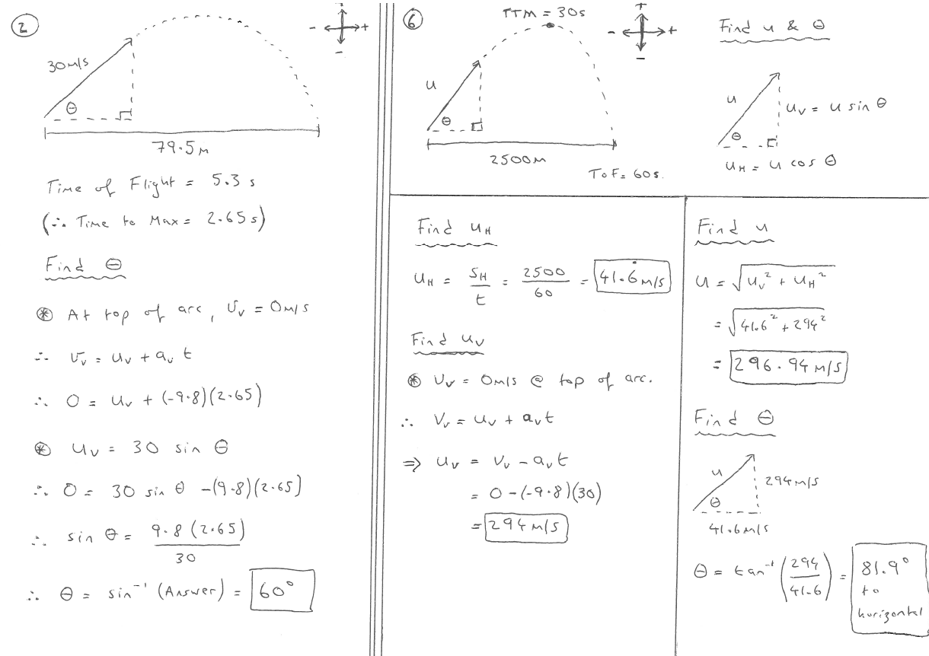

Slide 9
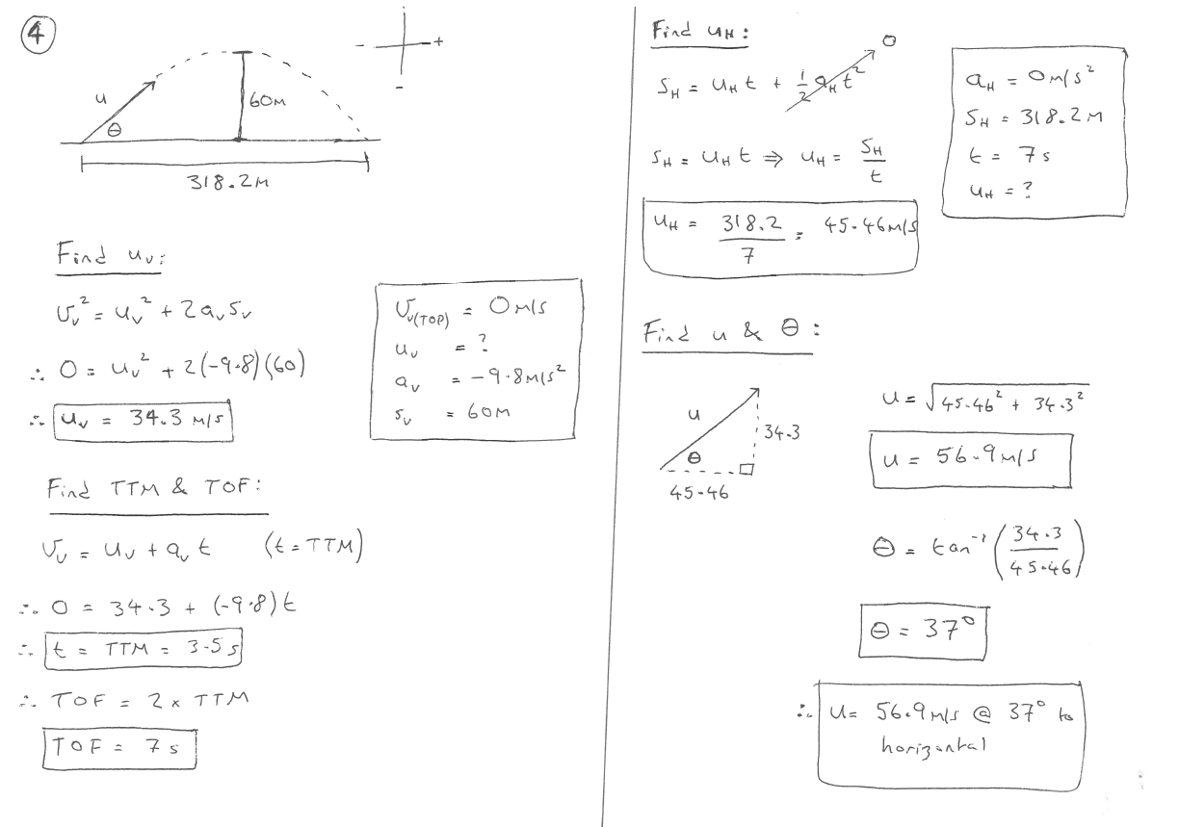

Slide 10
LAUNCHING PROJECTILES (DIFFERENT LEVELS)
Launching projectiles such that they start and finish at different elevations is another type of problem that we will be required to solve. However, the assumptions that we were allowed to make for same-level projectile motion no longer hold.
The flight path is no longer considered symmetrical about the point of maximum height. This means we cannot double the time to maximum height to find the total time of flight.
It also means that the initial and final velocities are no longer identical.

Slide 11
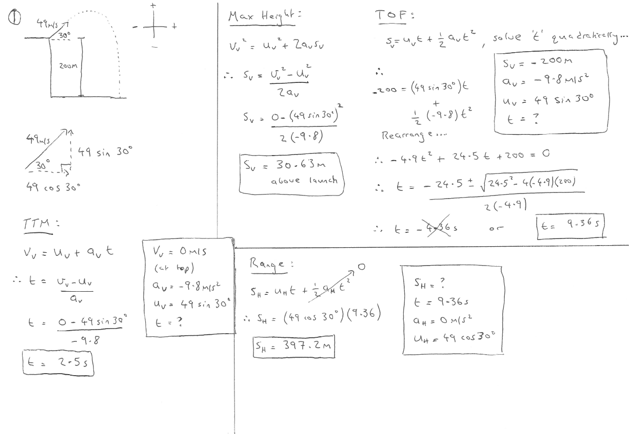

Slide 12
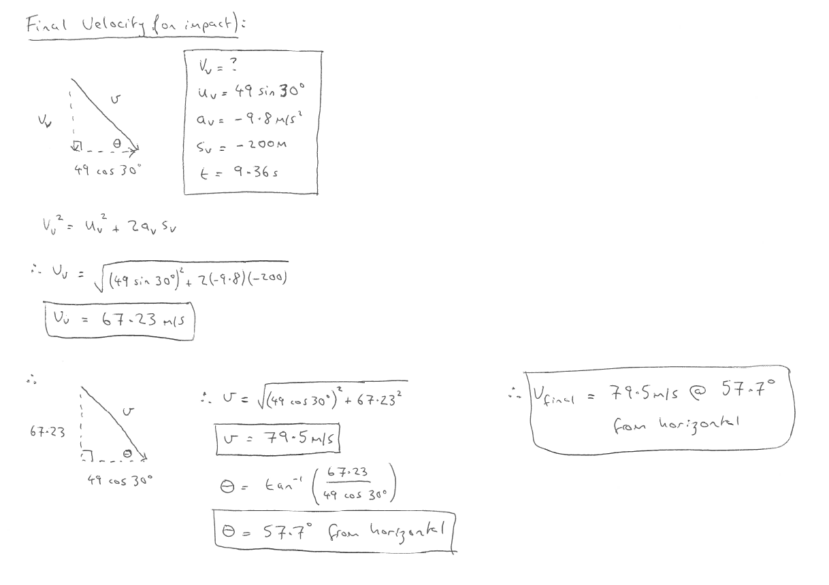
in the negative direction.

Slide 13
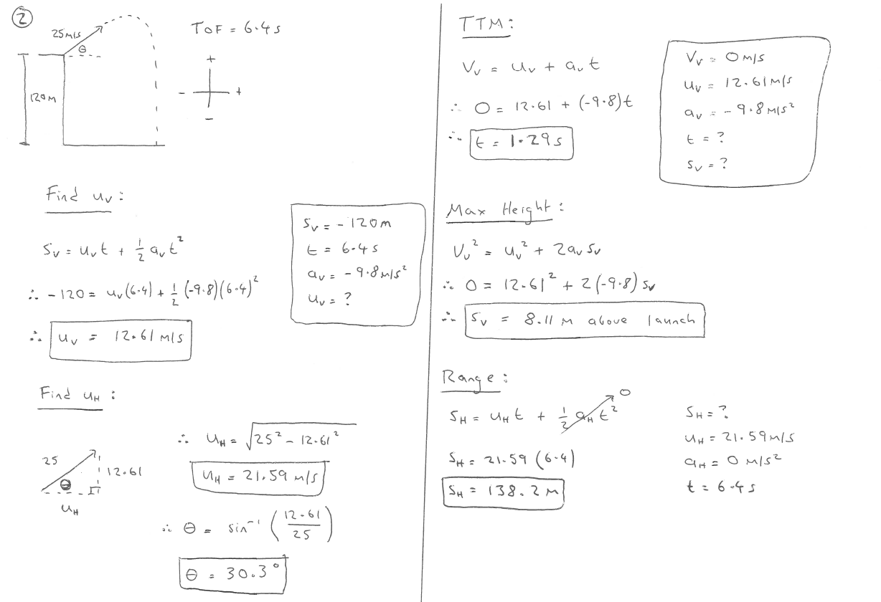

Slide 14
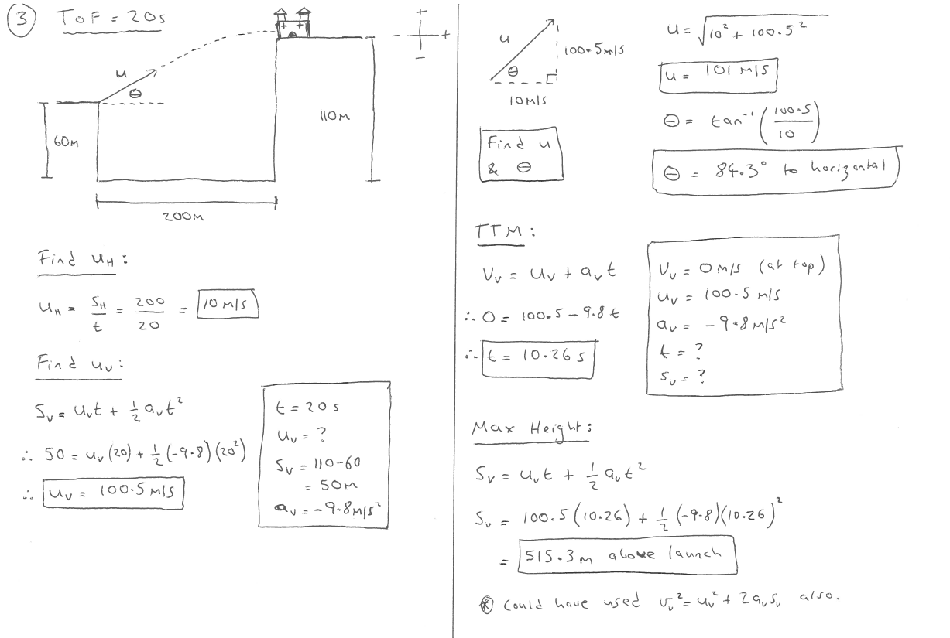

Slide 15
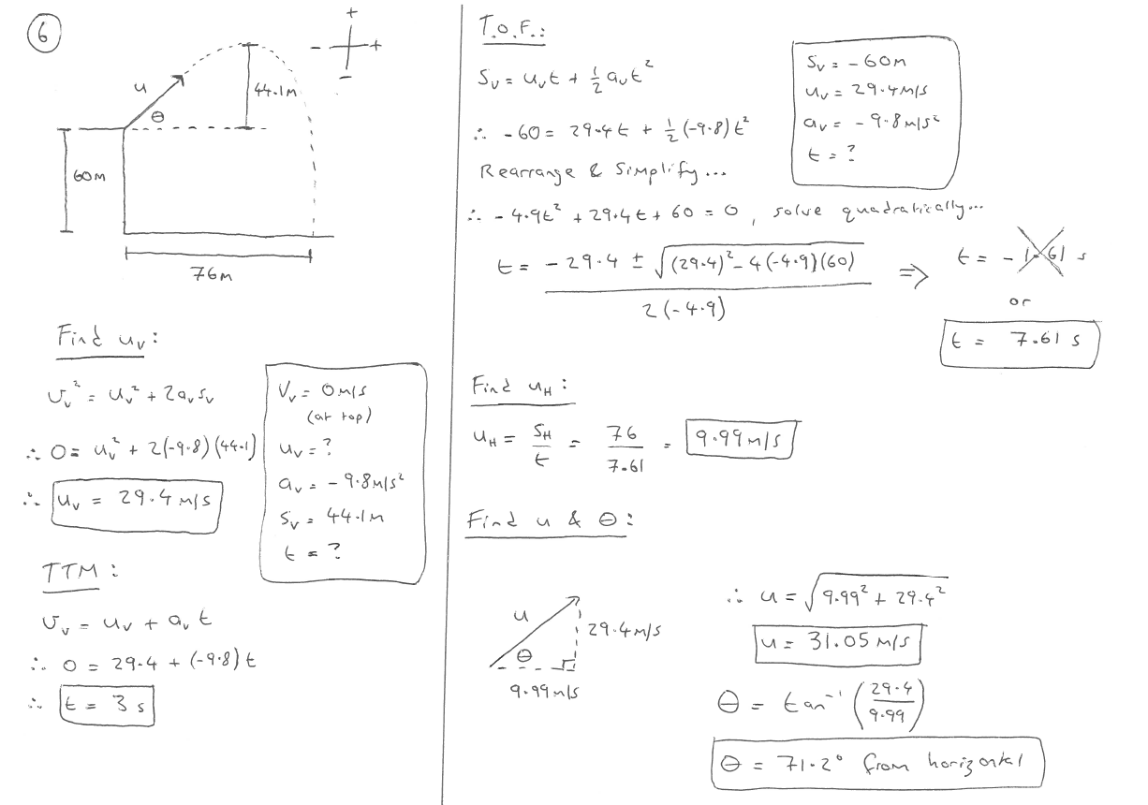

Slide 16
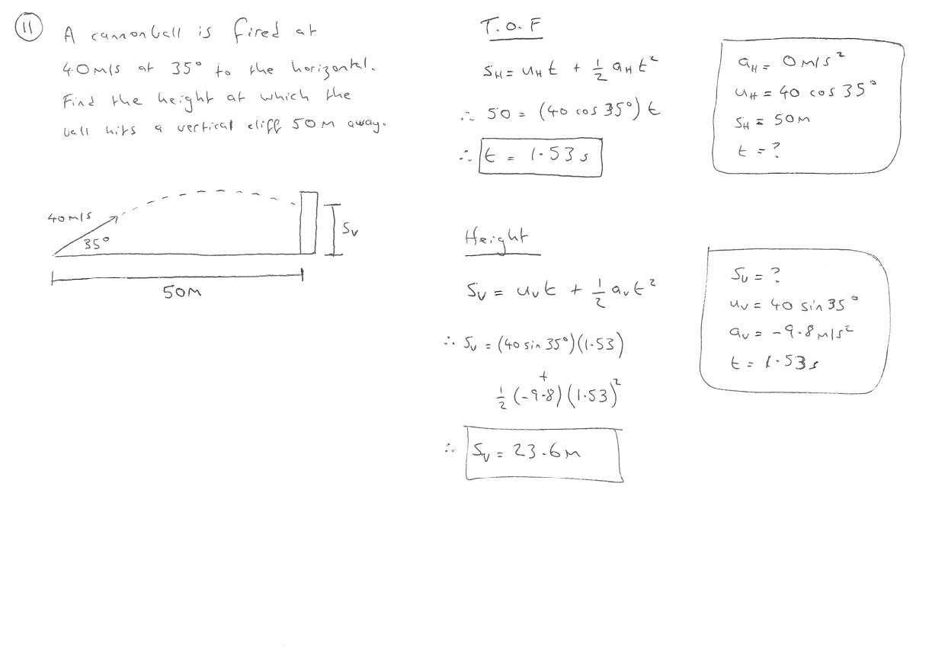

Slide 17
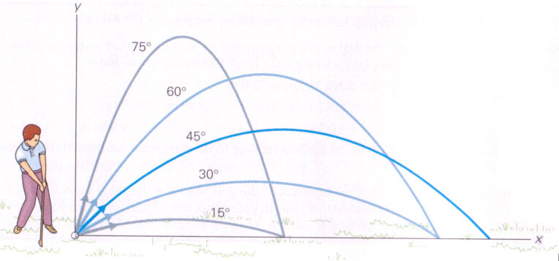
RANGE OPTIMISATION
Some questions will ask you to assume that a projectile has been fired at such an angle as to maximise (optimise) the range of said projectile (range is another term for horizontal displacement).
It turns out that there is one angle that will optimise range for almost all cases; θ=45˚ (the exception being if you’re firing into-or-over an obstacle, in which case common-sense prevails).
The proof is overleaf.

Slide 18
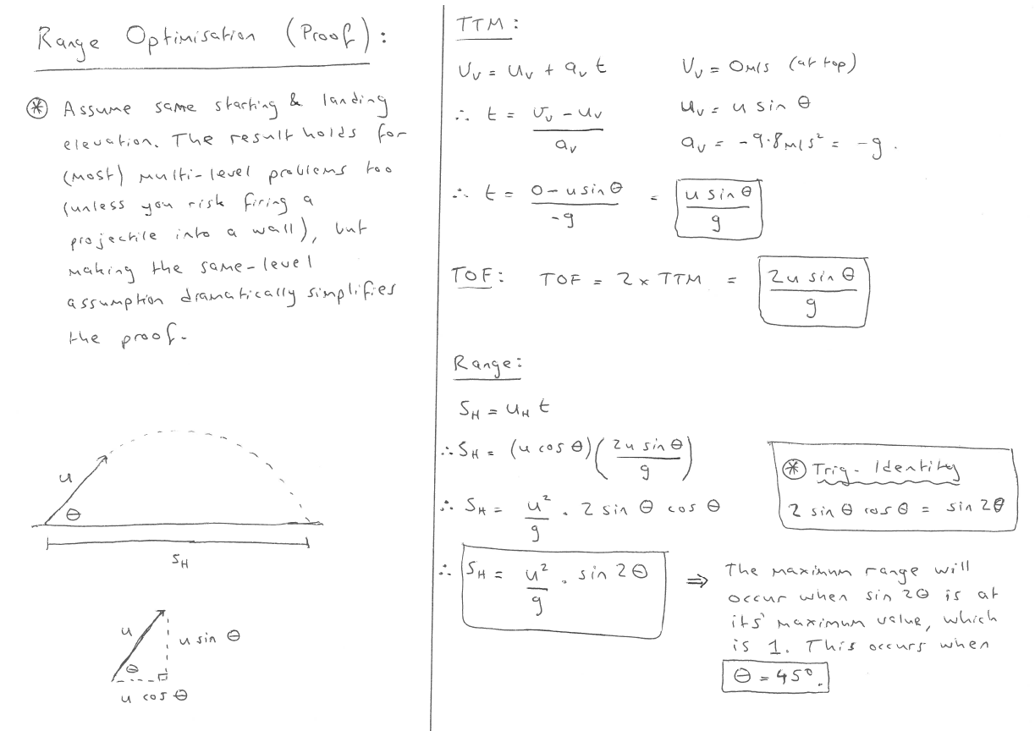

Slide 19
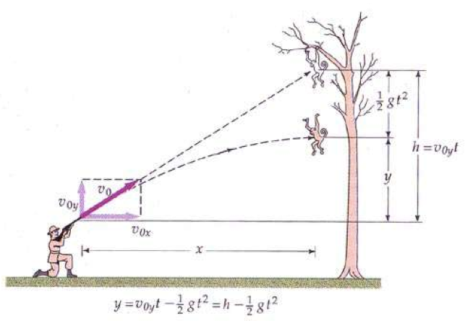
THE MONKEY & THE HUNTER
The Monkey & The Hunter is a Physics-classic. Although it is unlikely that you will be asked to complete this proof, it is still an interesting one to explore.

Slide 20
THE MONKEY & THE HUNTER
The story goes like this; our friend is a hunter who has had his wallet stolen by a monkey whilst on safari. Our friend had his passport in his wallet, and he flies home in the morning, so he really needs it back. In order to retrieve his wallet, he decides to shoot the monkey (we did ask whether he used a bullet or a tranquilizer dart – he was a bit fuzzy on that point).
However, the monkey is cunning! When the hunter aims directly at the monkey and fires, upon hearing the gunshot, or seeing the flash of the muzzle as the projectile is fired, the monkey will let go of the branch and enter freefall towards the ground to avoid getting shot. The hunter knows this (he knows how monkeys think… at least, that’s how he tells it), but he decides to aim directly at the monkey anyway, confident that he will hit his target. Is he right?

Slide 21
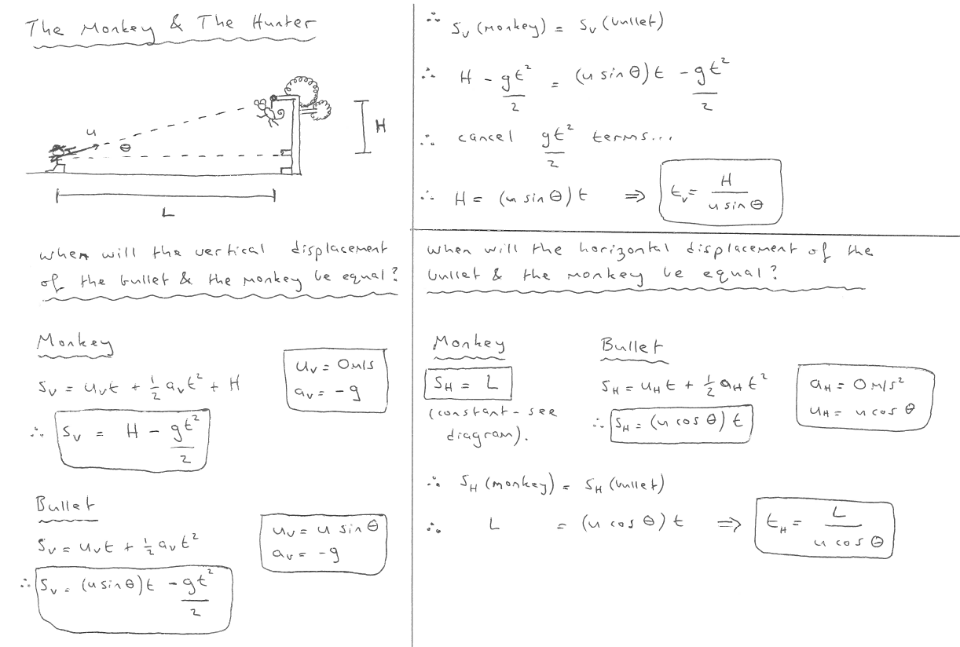

Slide 22
